Slide 1
Vista beans Data
File created on: 10/16/2020 11:37:27 PM

Slide 2
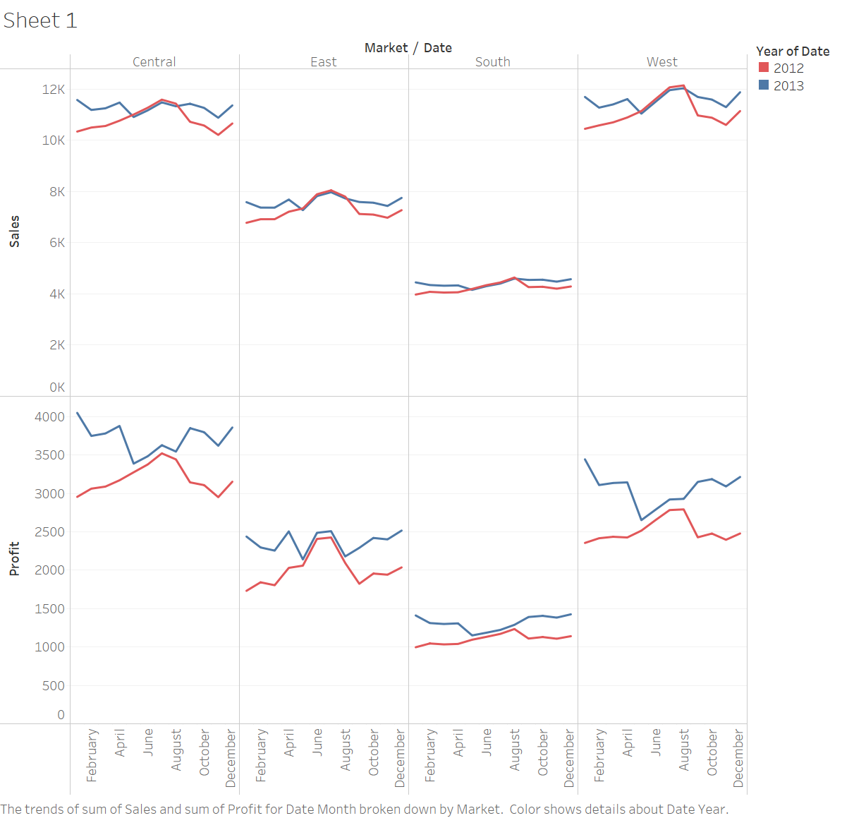

Slide 3
Line Graph
This line graph shows sales and profits over each month divided up by territorial market.
The Redline represents 2012 where the Blue line represents 2013. In the graph, each year sales and profits reflect nearly the same pattern during these two years.
The profits significantly increased from 2012 to 2013 without the corresponding increment in sales. This is a great discovery that the company increase profits even if sales did not jump.
In this graph, as compare to the all-region south region has the lowest number of sales and profits, though that its profits are equivalent to the other markets as a percentage of its sales.
The Central and West markets have equivalent sales amounts for each year, although the Central market is suitable to utilize a larger profit than the West.
To maximize profit, the company needs to compare how the Central market has a higher profit than the West and they need to look at pricing, expenses they are contracting, and turnover of the inventory is also important for measuring a profit.

Slide 4
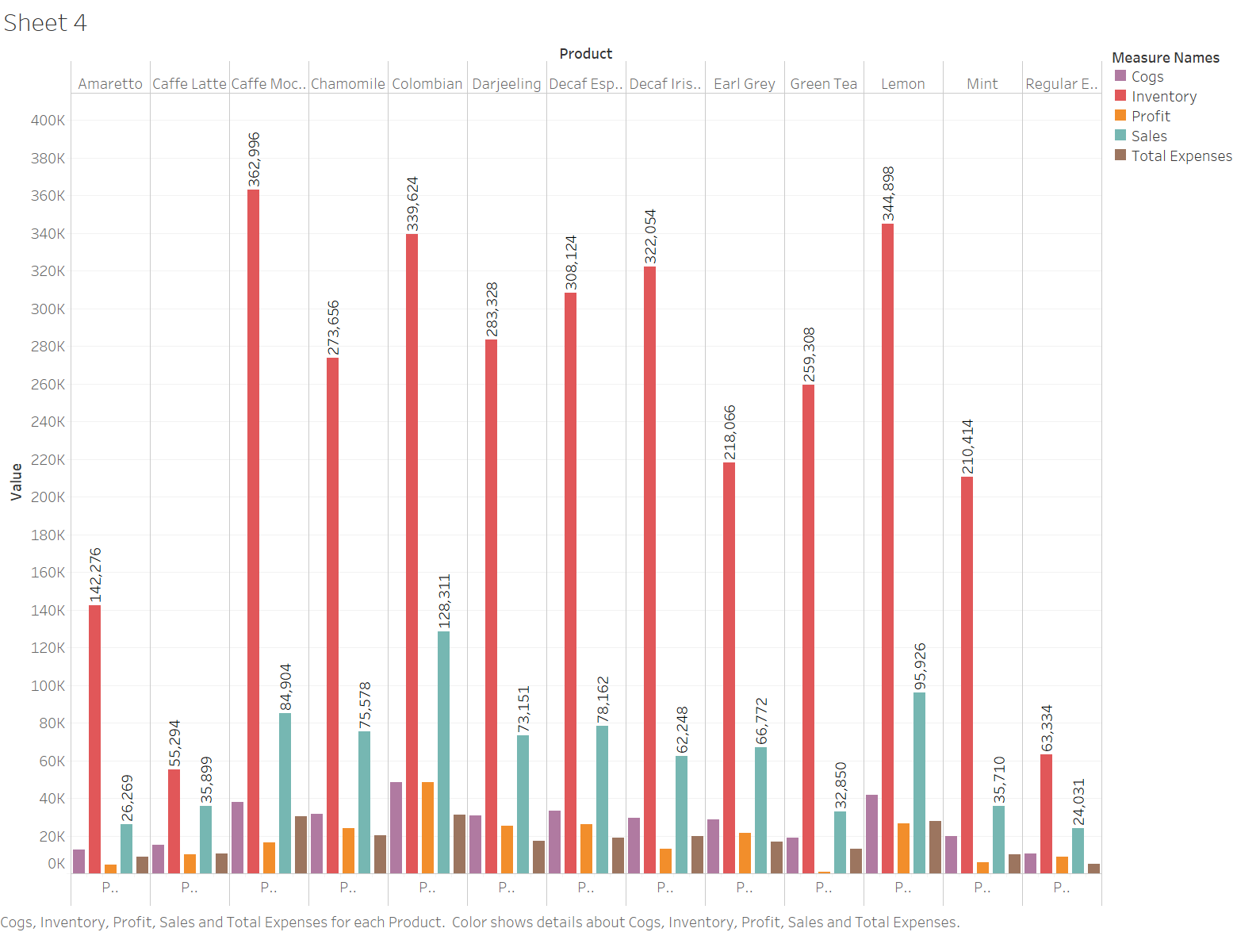

Slide 5
Bar Graph
This graph is labelled Coffee chain Companies products Green tea, Coffee Latte and Amaretto are not doing well for the company.
For this graph, we can see all the products and their profit, Inventory sales and total expenses.
Green Tea sales are like Caffe Latte and sell more Green Tea than the Amaretto and Regular Espresso. So why do the company have a negative profit for some of these products?
The problem arises with the Cost of Goods Sold and Total Expenses columns.
If the company cannot find a way to decrease costs, then they need to increase the selling price for each low-profit Products.
If this is not possible then the company needs to consider not offering low-profit products anymore since it is costing more than they are making.

Slide 6
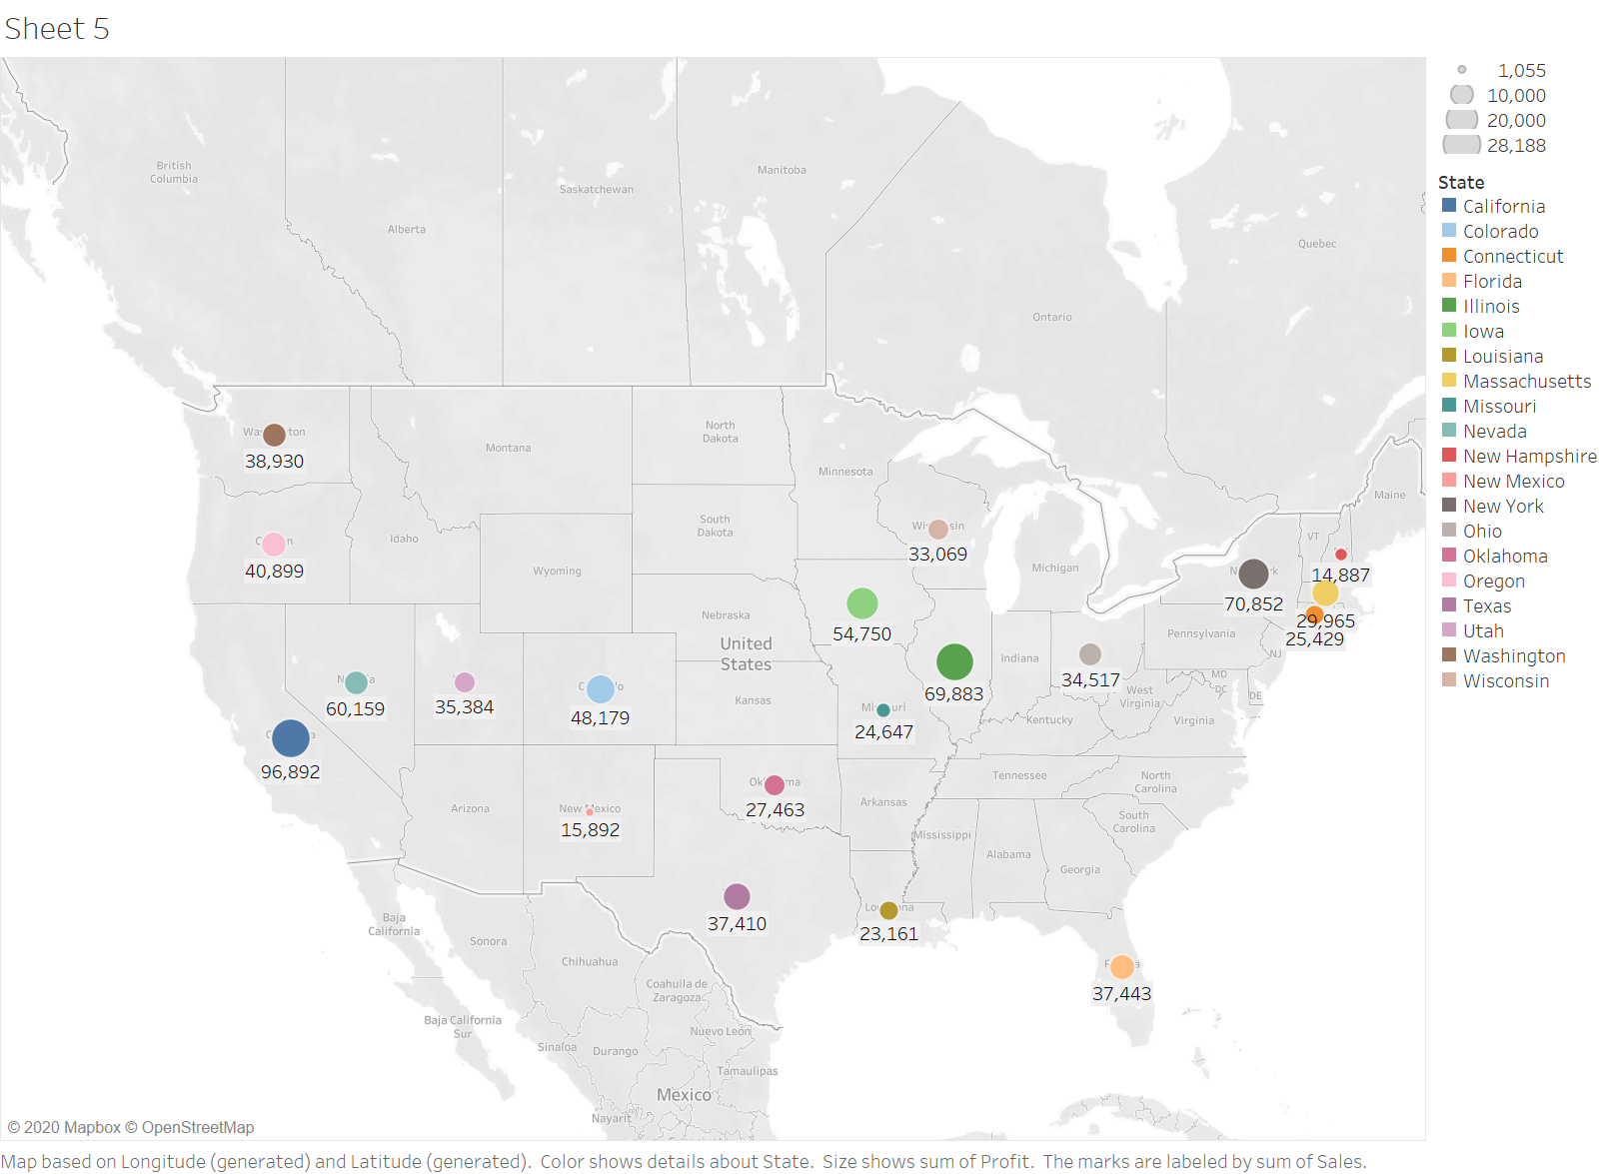

Slide 7
Graphical Representation
In this graph, the geographical representation for state-wise sales for the company products and profits is shown. However, the company can reduce the production of states which has lower profits overall for all products.

Slide 8
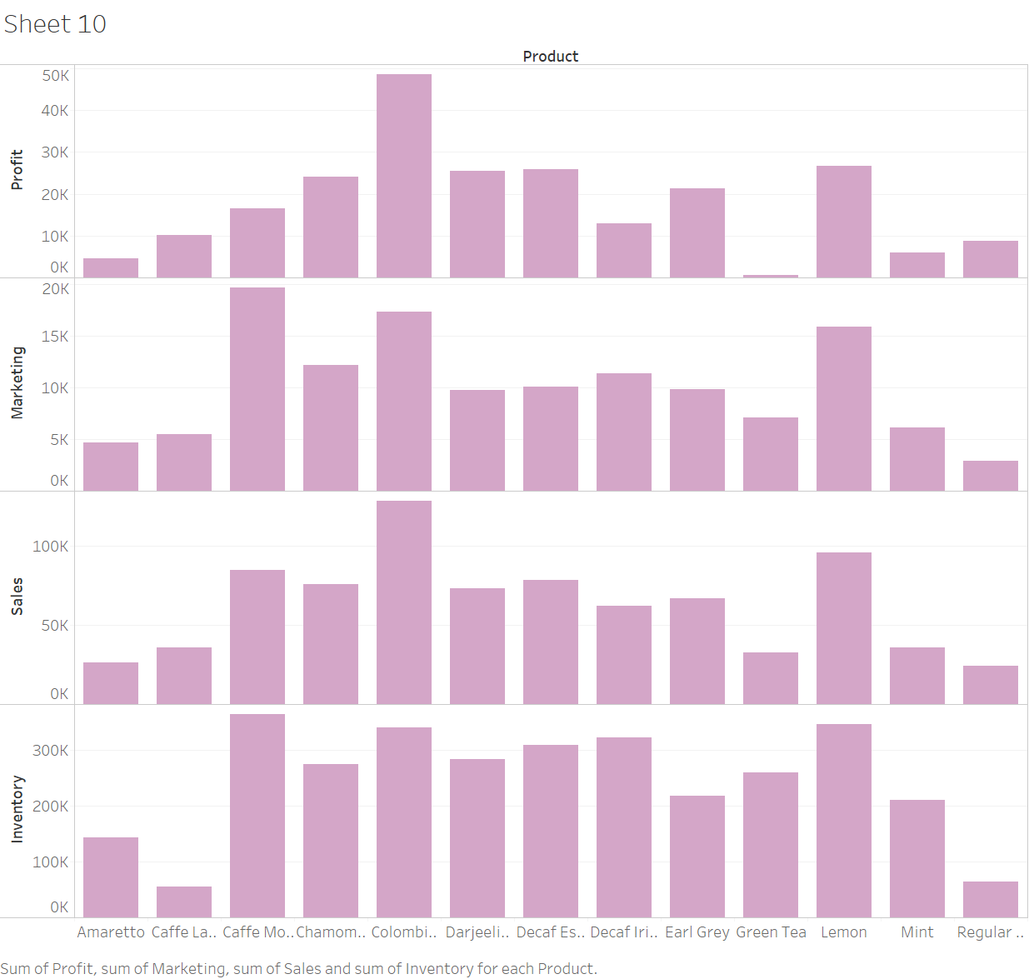
Adjust marketing expenditures - Bar graphs

Slide 9
Bar Graph for Sales Inventory and Profit
This graph analysis of Marketing, Sales Inventory and Profit for all of the products which are marketed throughout the country.
For every product, company's sell, use a rough percentage of each sales dollar to spend on marketing.
If we consider analysis done for Sales and Marketing, for the most part, each individual product’s Marketing to Sales ratio is about the same. however, there are huge variations in Inventory to marketing analysis.
Caffe Mocha has nearly close to the number of sales as Chamomile, but Caffe Mocha has more marketing price.
Caffe Mocha’s marketing is costing us nearly double the percentage of sales as the other products, but profit is not that god for Caffe Mocha, however sales and marketing cost for Colombian is almost high but that products profit is also high. Here, in turn, is presenting the profits level is decreasing.

Slide 10
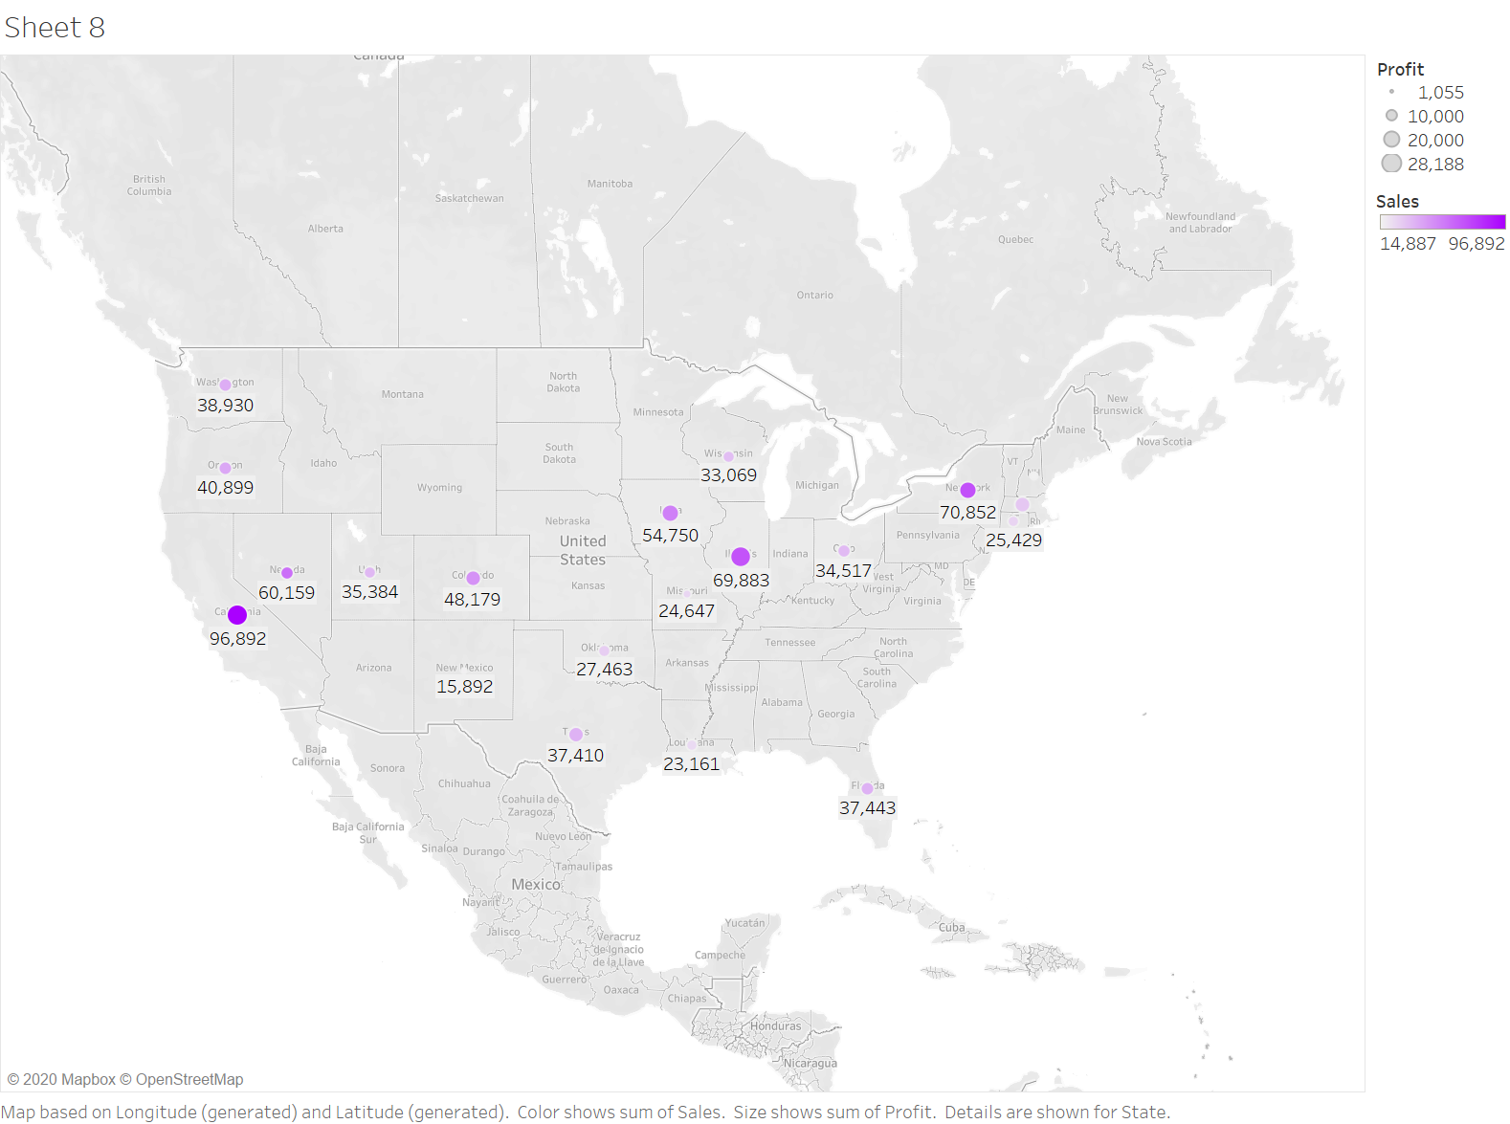

Slide 11
Geographical Graph Investigate potential inventory and accounting errors- Map graphs
This geographical graph shows the inventory of the company’s products with detail inventory amounts. As we can see states wise analysis of the product inventory and there are some states with the lowest inventory and the highest inventory for the products.
Some states like Oklahoma, Texas has lower inventory as compared to California and Nevada has the highest inventory. Though the light blue color shows the lower inventory state where dark blue shows higher inventory states.

Slide 12
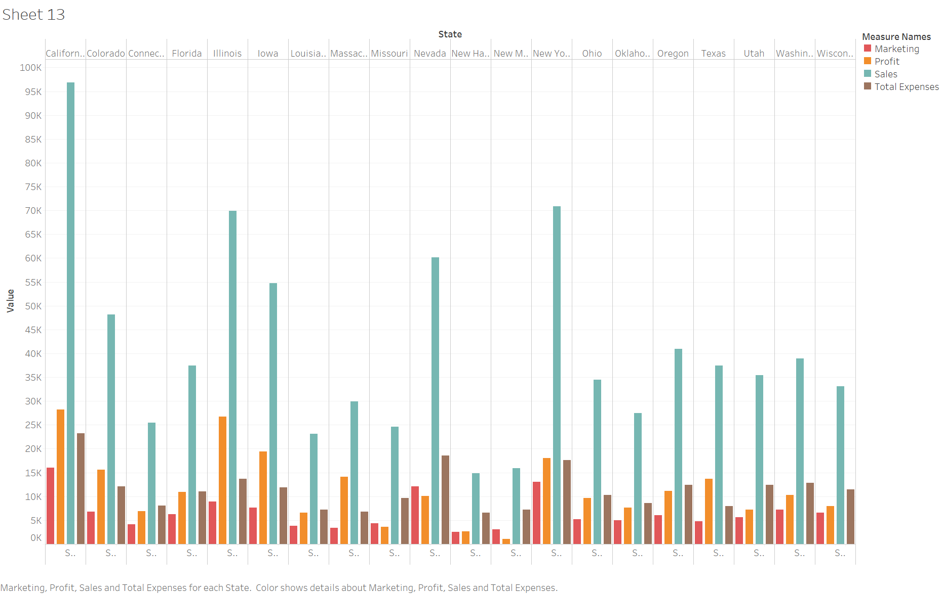

Slide 13
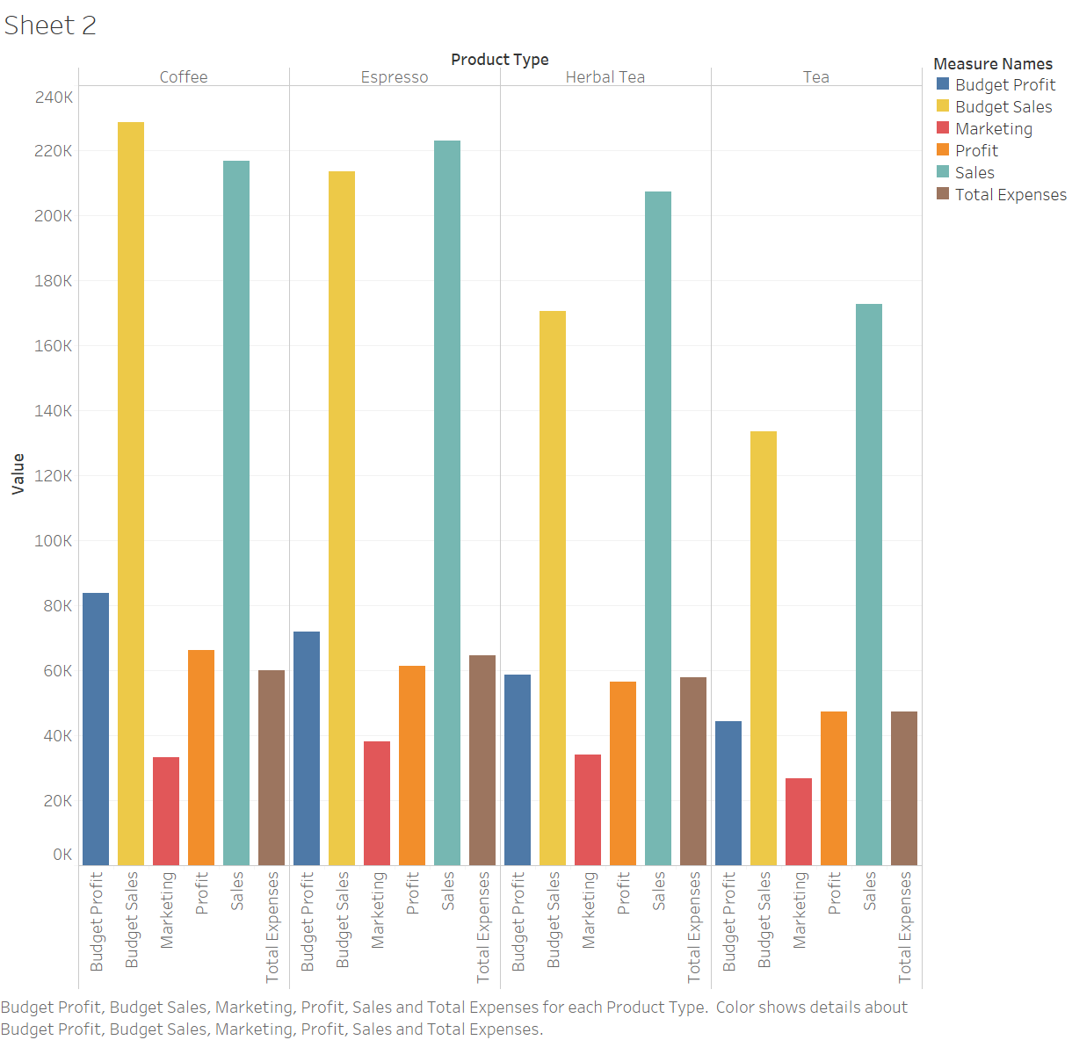

Slide 14
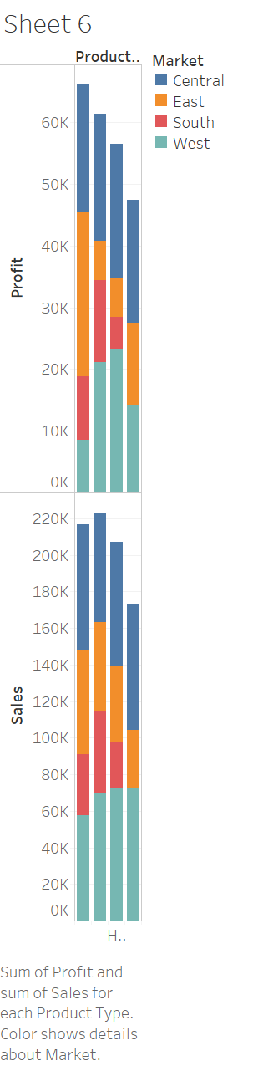

Slide 15
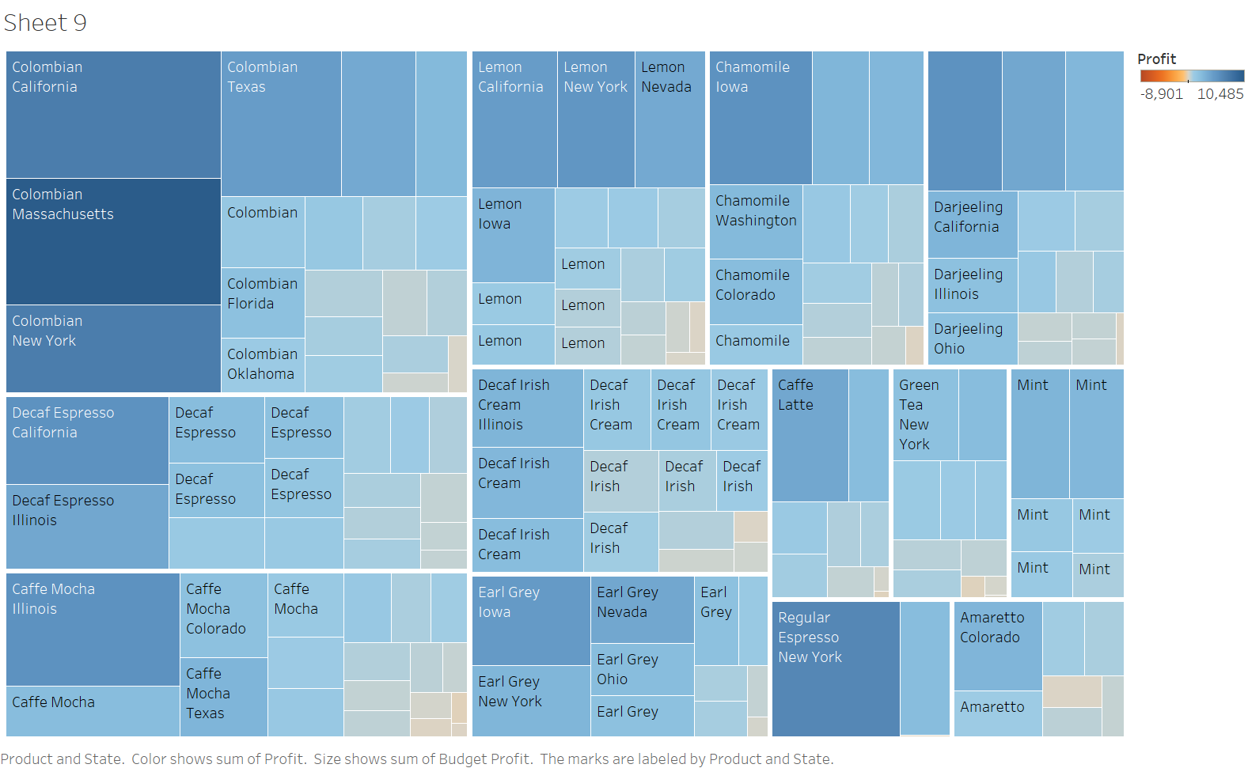

Slide 16
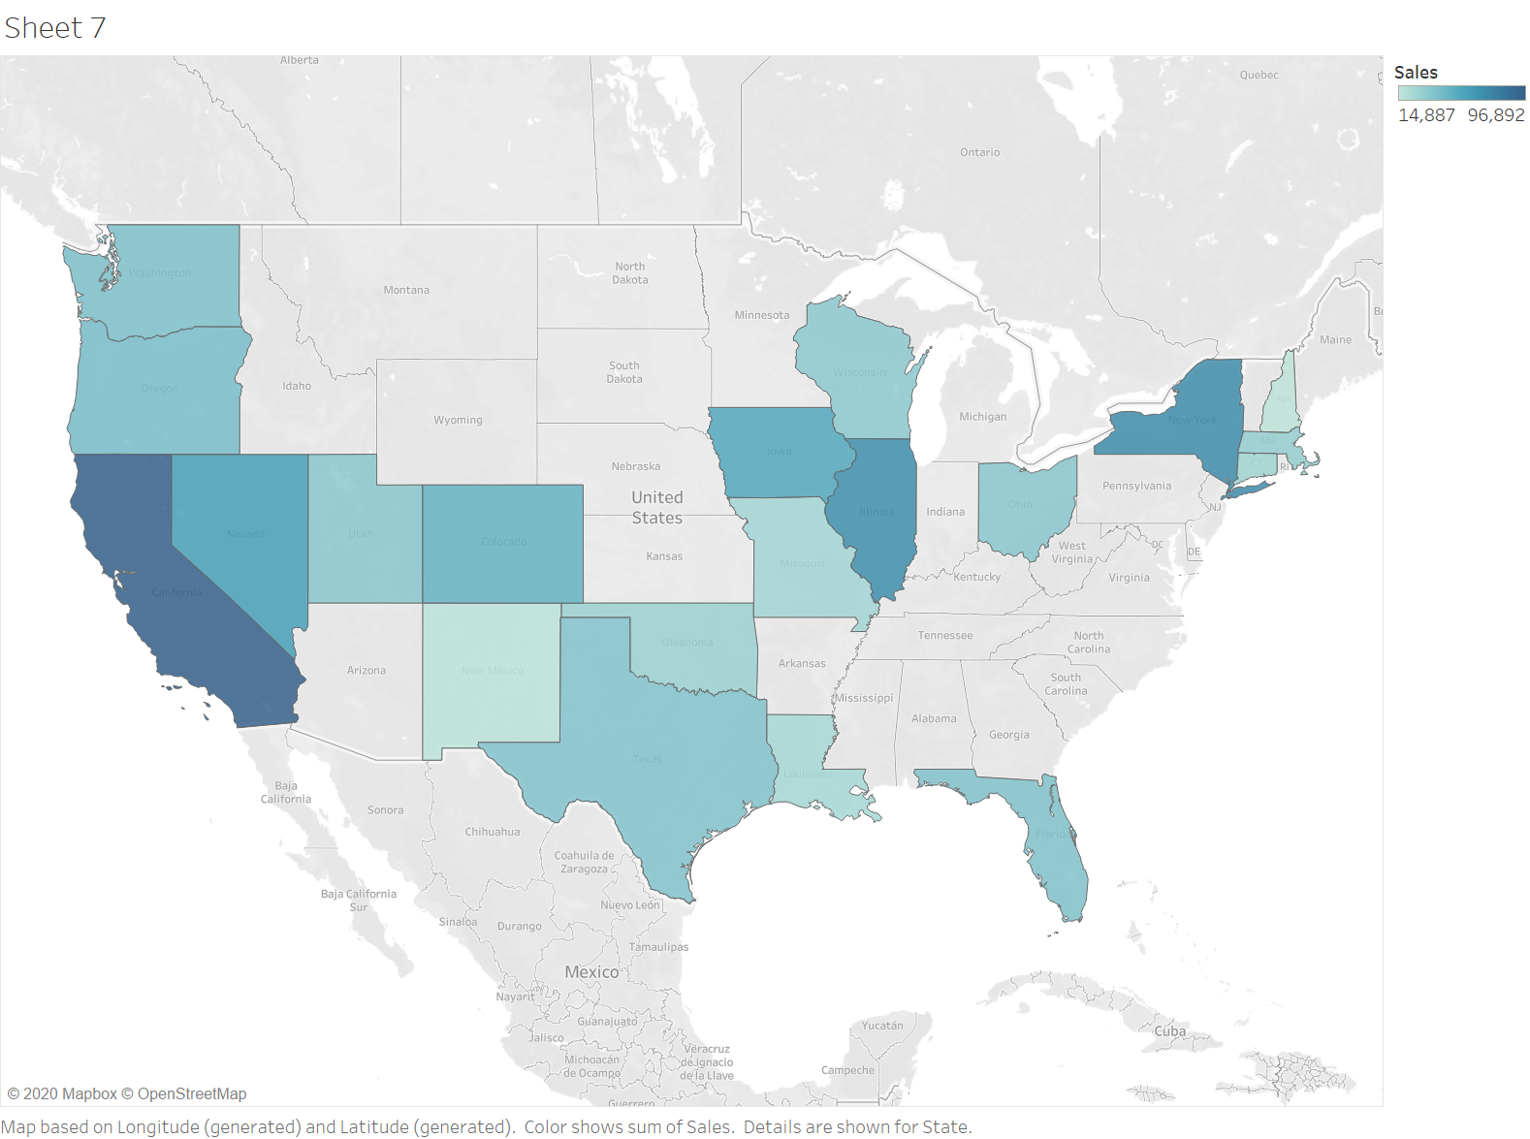

Slide 17
